Slide 1
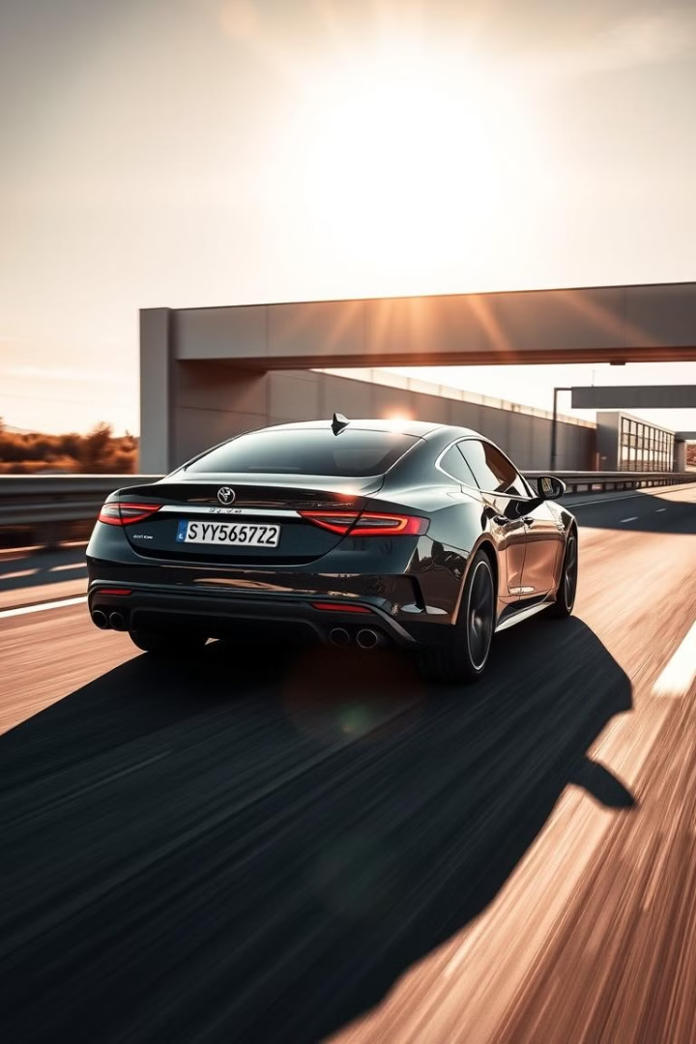
Dynamic Vehicle Plate Identification
Welcome to the presentation of my Vehicle Plate Detection project. This project showcases the implementation of a robust system capable of accurately extracting license plate information from images and videos.

Slide 2
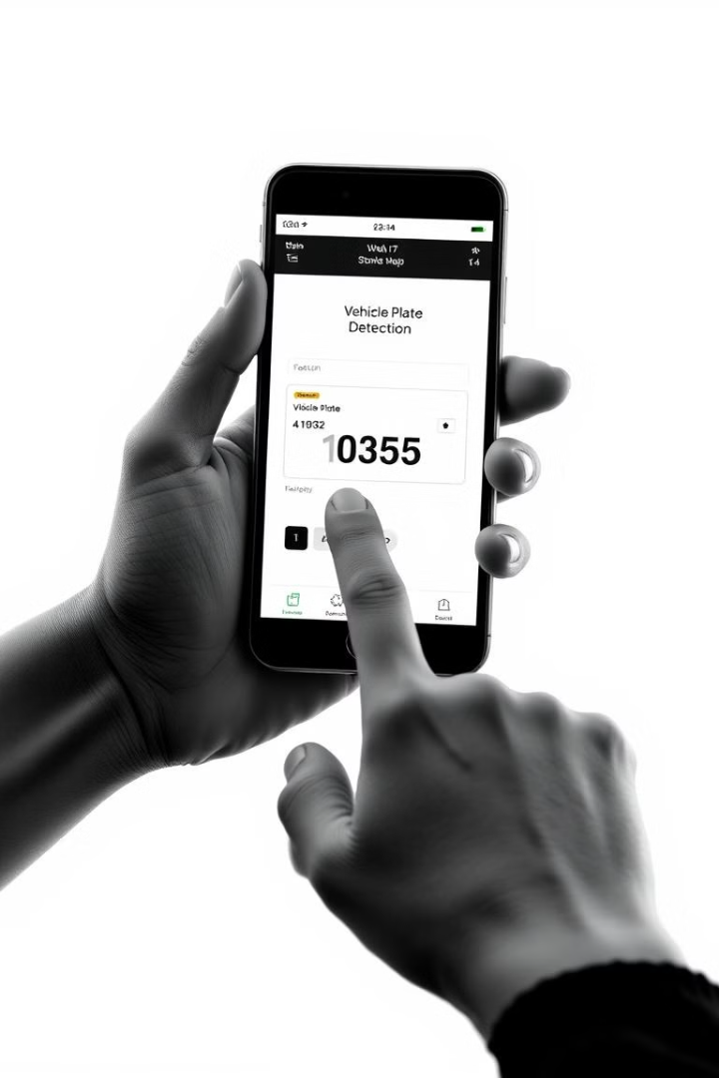
TEAM MEMBERS
Manideep
Bhavya
Sunidhar
Nishith Reddy

Slide 3







Technologies & Frameworks Used
HTML
CSS
Bootstrap
JavaScript
Django(Python)
Pytesseract
OpenCV
mysqlite3

Slide 4
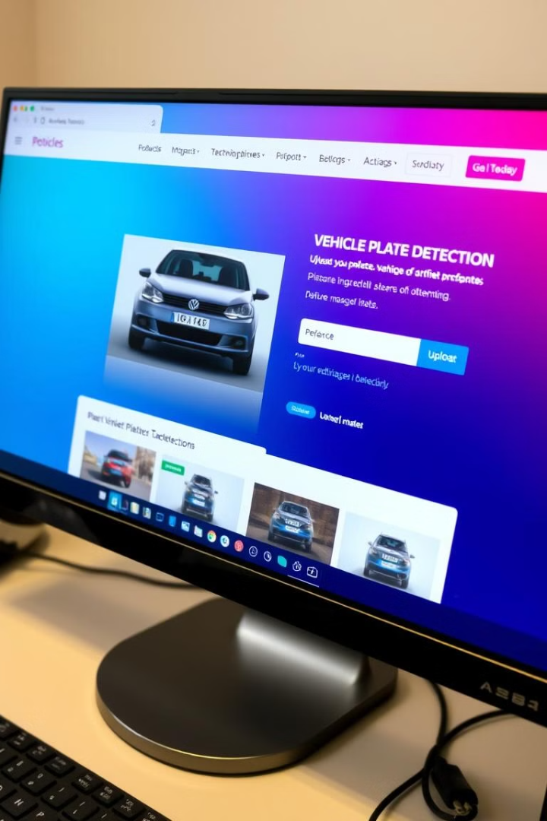
Introduction and Project Overview
1
Project Goal
2
Key Features
The primary objective of this project was to develop a web-based application that could effectively detect and extract license plate characters from uploaded images and videos of vehicles.
This project encompasses features such as user-friendly image and video upload, efficient number plate detection, and clear display of extracted characters.
3
Target Audience
This application targets individuals and organizations requiring vehicle plate information for various purposes, including security, traffic management, and parking enforcement.

Slide 5
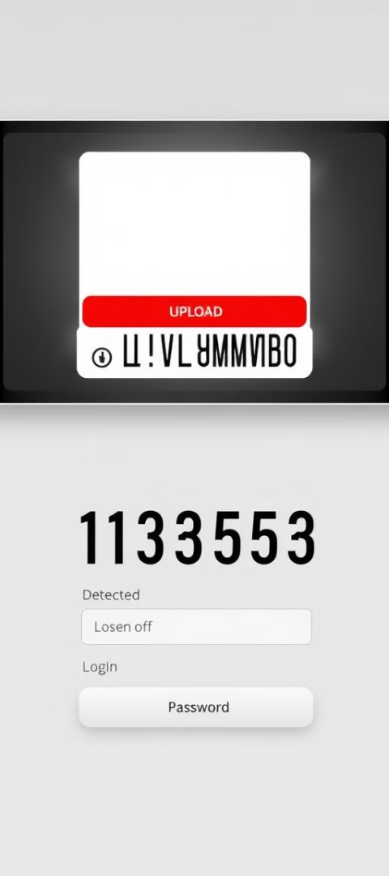
User Interface Design
Homepage
Login/Sign-up
Image and Video Upload
The homepage welcomes users with a brief introduction to the application and its features. It provides access to the login and sign-up pages.
Secure login and sign-up forms are designed for user authentication. They are accessible from the homepage and provide a secure and seamless user experience.
A dedicated section allows users to upload images and videos of vehicles. It will display the extracted license plate to the user.

Slide 6
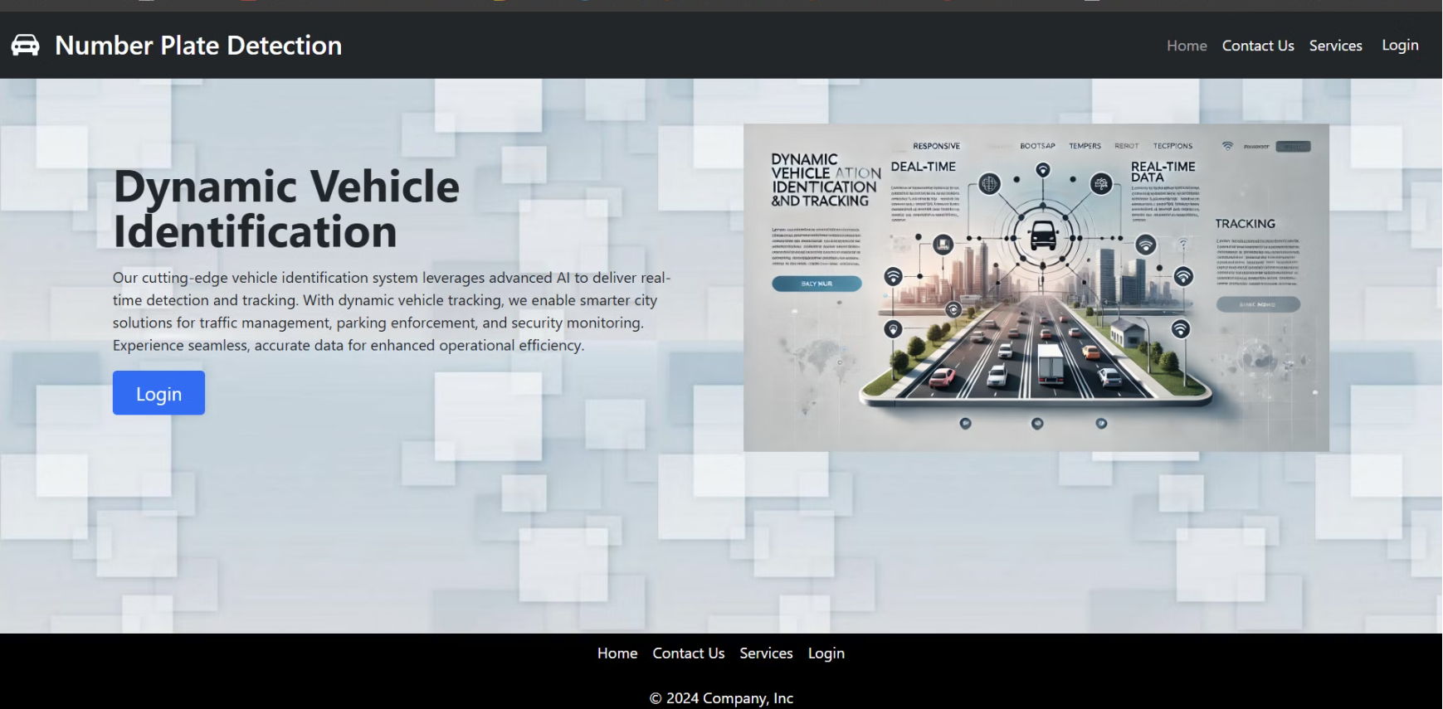
Home page

Slide 7
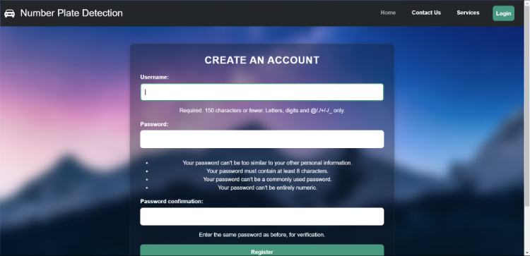
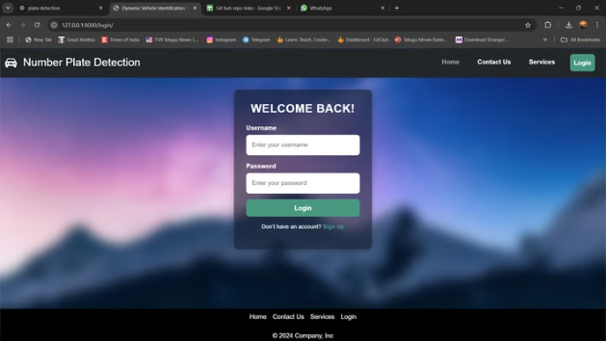

Login Page and Sign In page

Slide 8
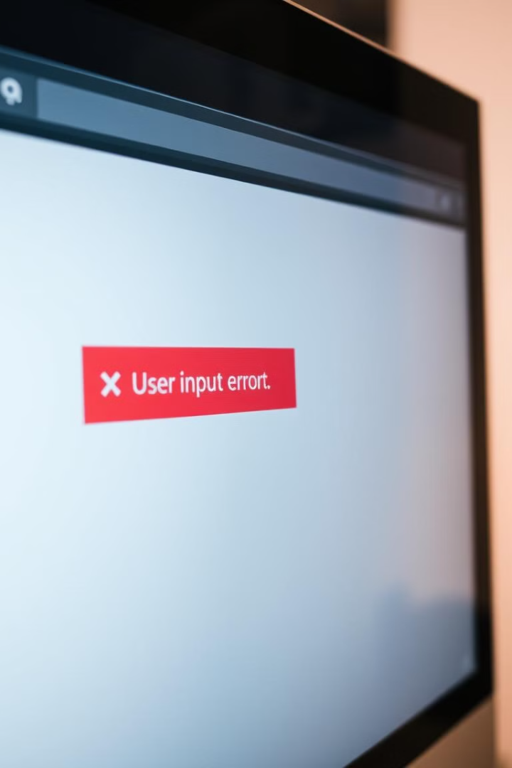



Form Validations
Login Validation
Validation ensures that user inputs for username and password meet specific criteria, preventing invalid entries and maintaining security.
Sign-up Validation
Similar to login, validation checks for correct email format, password strength, and other criteria to ensure accurate data input.
Image and Video Upload Validation
Validation ensures that uploaded images meet specific requirements, such as file type, size, and resolution, to optimize processing.

Slide 9
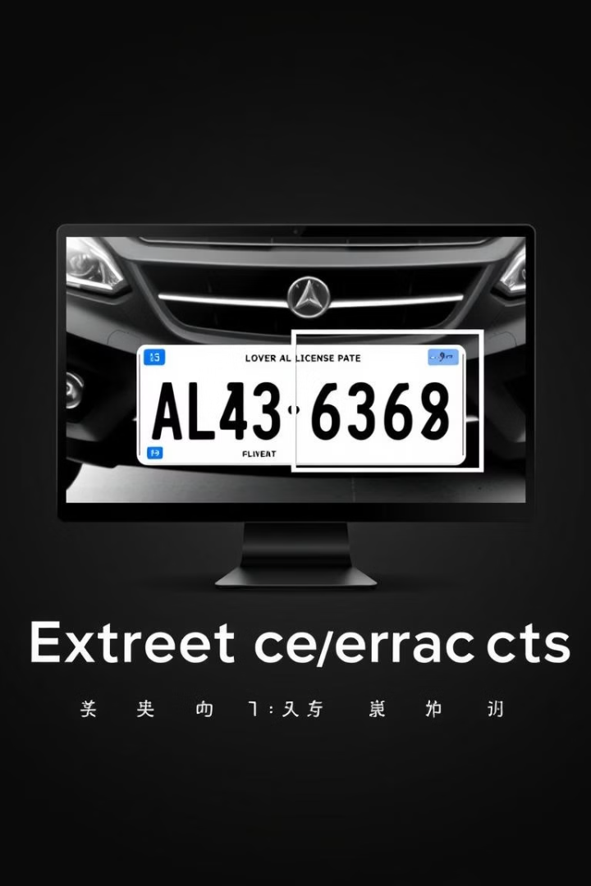
Number Plate Character Extraction Model
1
Image and Video Preprocessing
The model first preprocesses uploaded images, applying techniques to enhance image quality and prepare it for character extraction.
2
Number Plate Detection
A machine learning model is used to accurately locate the number plate within the image, focusing on key features and patterns.
3
Character Recognition
Once the plate is identified, individual characters are extracted and recognized using character recognition algorithms, ensuring accurate translation.

Slide 10
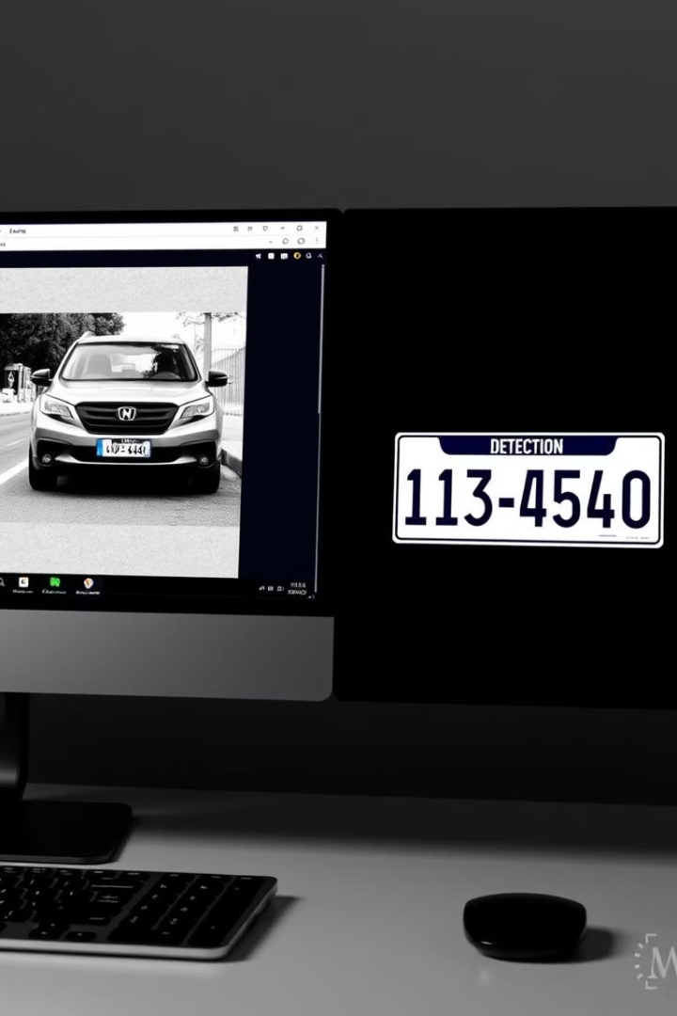
Image Video Upload and Result Display
Image and Video Upload
Users can upload images and videos of vehicles directly from their devices, providing a convenient way to access the application's capabilities.
Result Display
The extracted license plate characters are displayed clearly and prominently, ensuring users can easily access and verify the information.

Slide 11
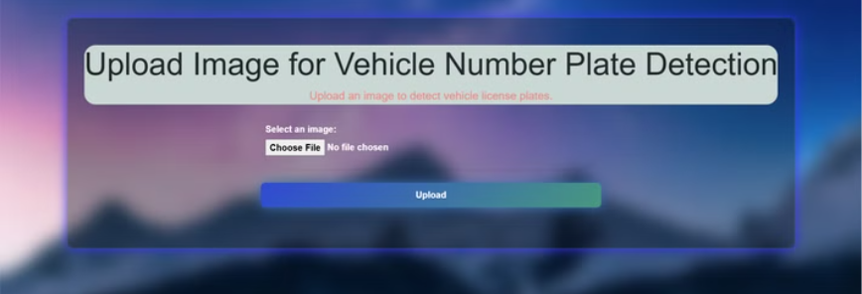

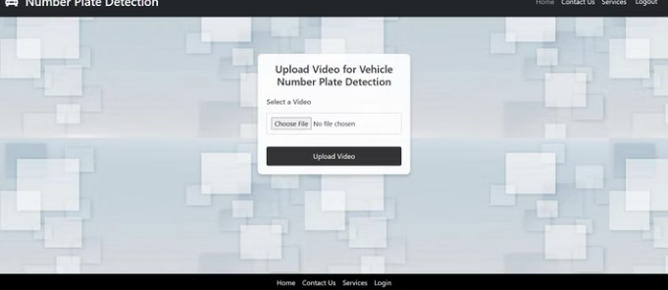
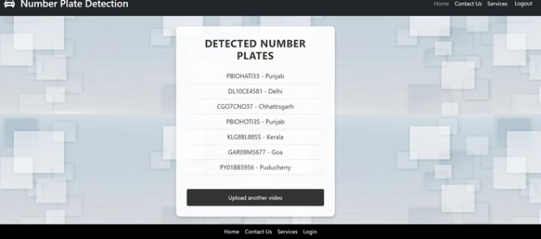

Web Pages

Slide 12
Tem Contributions
Manideep
Bhavya
Sunidhar
Nitish
Designed the backend logic, including video-based number plate detection and enhanced the frontend for better user experience.
Developed robust form validations and implemented user login and sign-in authentication features to ensure secure user access.
Focused on the frontend design, creating a visually appealing and user-friendly interface for the website.
Worked on image-based number plate detection using PyTesseract, ensuring accurate text extraction from static images.

Slide 13

Challenges and Limitations
Lighting Conditions
Plate Obstructions
The model's accuracy can be affected by varying lighting conditions, particularly in low-light or backlit situations, impacting character recognition.
Obstructions such as dirt, scratches, or partially obscured plates can hinder the model's ability to accurately detect and extract characters.
Plate Variations
Different plate formats and styles across regions and countries can pose challenges for the model's ability to generalize and recognize variations.

Slide 14
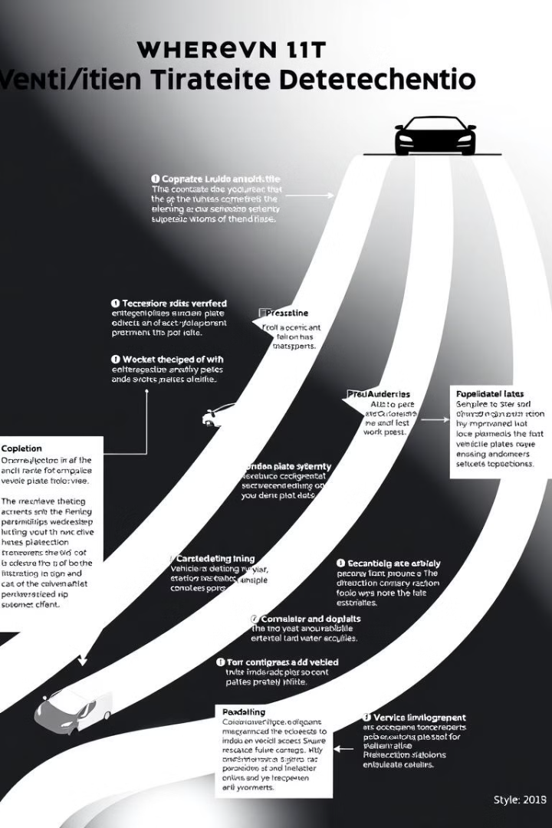
Future Enhancements and Improvements
1
Improved Accuracy
2
Enhanced User Interface
Future enhancements focus on refining the model's accuracy by incorporating advanced algorithms and training data to handle challenging scenarios.
Further improvements to the user interface can include intuitive navigation, more informative feedback, and the ability to save and manage extracted plate data.

Slide 15

Thank You!

